Slide 1


The Welsh Language Commissioner

Slide 2




The Welsh Language today

Slide 3

Around 43% of the world's population is bilingual
(can speak two languages).
43%
Almost 20% of the world's population is multilingual (can speak more than two languages).
20%

Slide 4
Discussion work
Why is it a good thing to be able to speak more than one language, in your opinion?

Slide 5

Bilingual people are often more sensitive and creative.

Slide 6

Bilingual people are often better at learning new languages.

Slide 7
Speaking two languages helps us learn about more than one culture and history.

Slide 8
Speaking two languages gives us more opportunities to make friends.

Slide 9
Speaking two languages improves our concentration and memory.

Slide 10
Bilingual people often show more interest and respect towards other cultures.

Slide 11
Bilingual people often
find it easier to concentrate on more than one task at the same time.

Slide 12
Speaking two languages gives us an opportunity to enjoy more hobbies and interests.

Slide 13


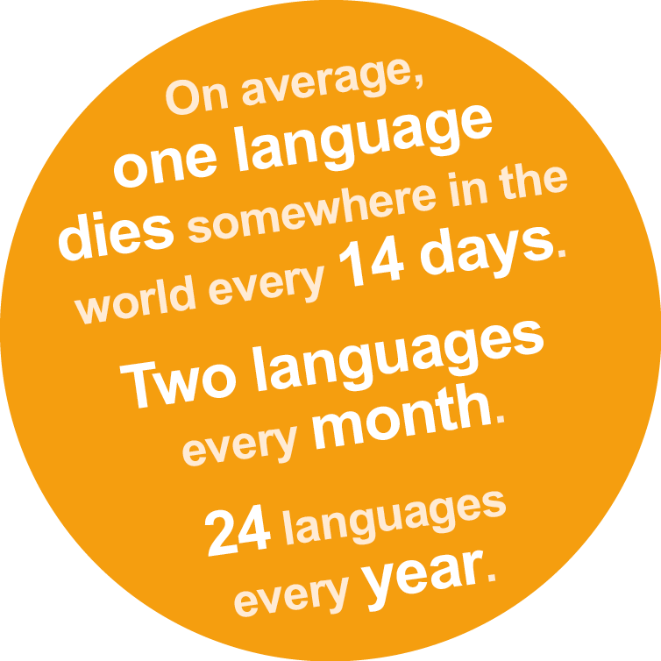


Did you know?

Slide 14
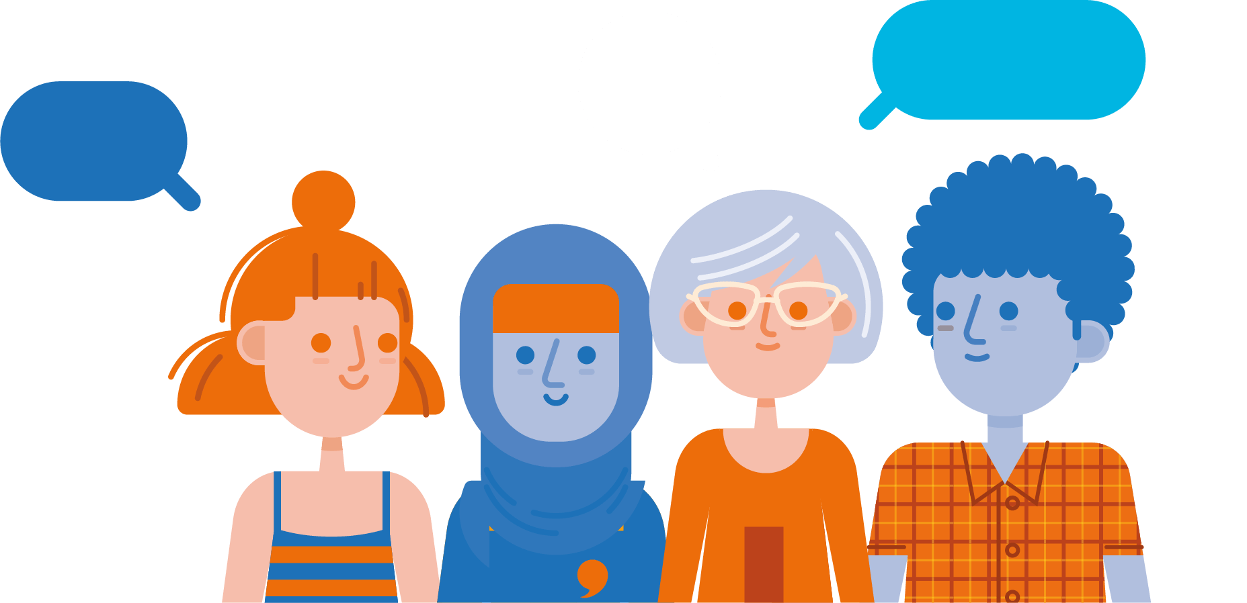
A Million Welsh Speakers by 2050

Slide 15
Welsh Government want more people to be able to speak and use the Welsh language in Wales. The target is a million Welsh speakers by 2050! How old will you be in 2050?

Slide 16
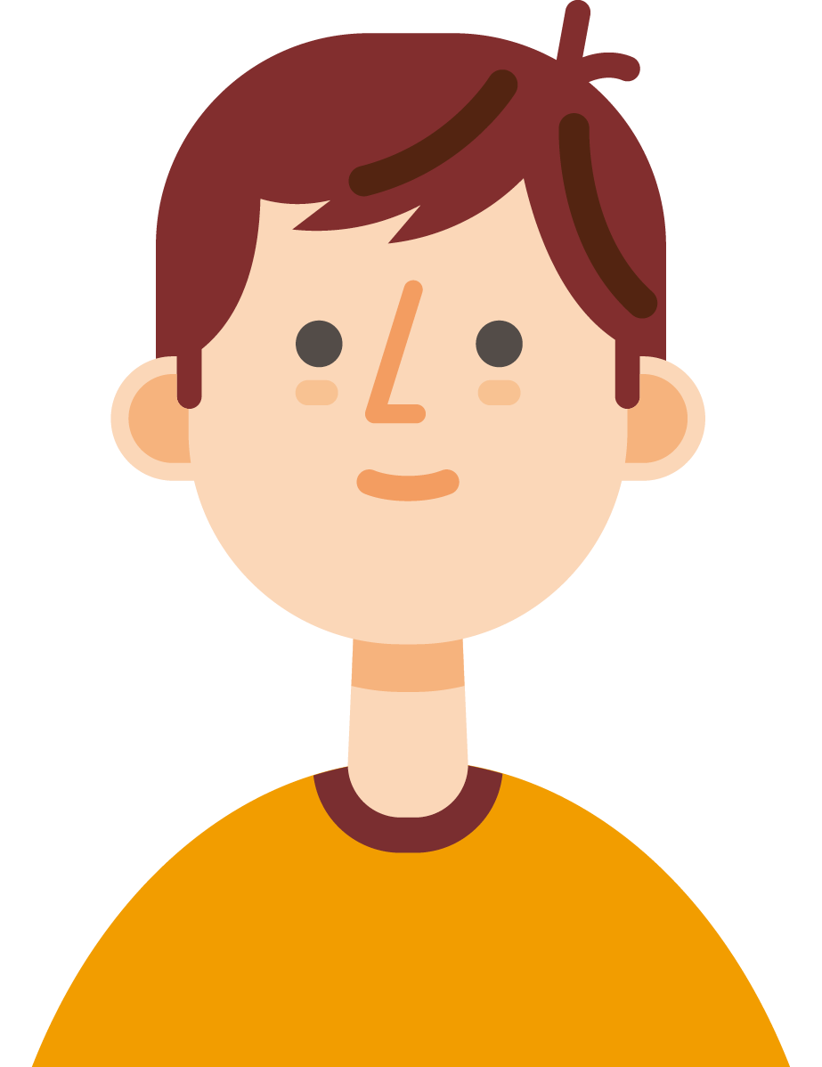


The Welsh language
is one of the treasures of Wales. It is part of what defines us as people and as a nation. Our ambition as Welsh Government is to see the number of people able to enjoy speaking and using Welsh reach a million by 2050.
Cymraeg 2050, Welsh Government

Slide 17
Discussion
work
How many of you here can
speak, or understand, some
Welsh? If you can speak some Welsh, do you enjoy speaking it? How much of it do you use in your everyday life? Where? And with who? Do you make as much use of your Welsh as you could? If not, why?

Slide 18

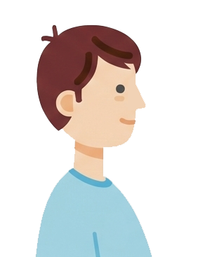
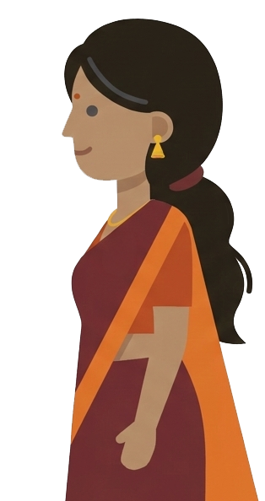
We all need to look after the Welsh language and speak it as much as possible if we want to be able to hear and use it in the future.

Slide 19


Who is the
Welsh Language Commissioner and what do they do?

Slide 20



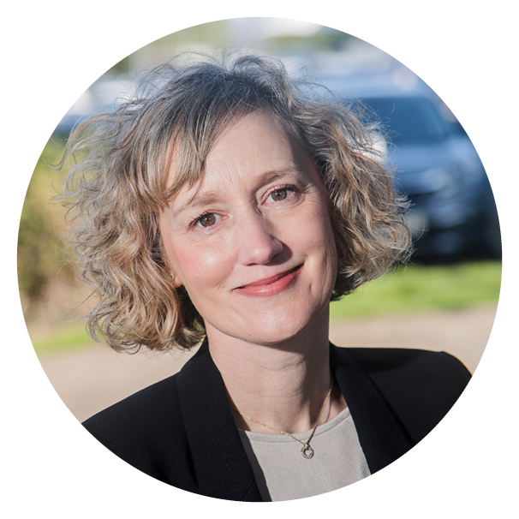


Who is the Welsh Language Commissioner?
Efa Gruffudd Jones is the Commissioner since January 2023.
Facts about the Commissioner:
Comes from Swansea originally.
Really likes supporting the Welsh football team.
Enjoys travelling and seeing different countries
all over the world.
Wants to make sure that the people of Wales can use the Welsh language in their everyday lives.

Slide 21
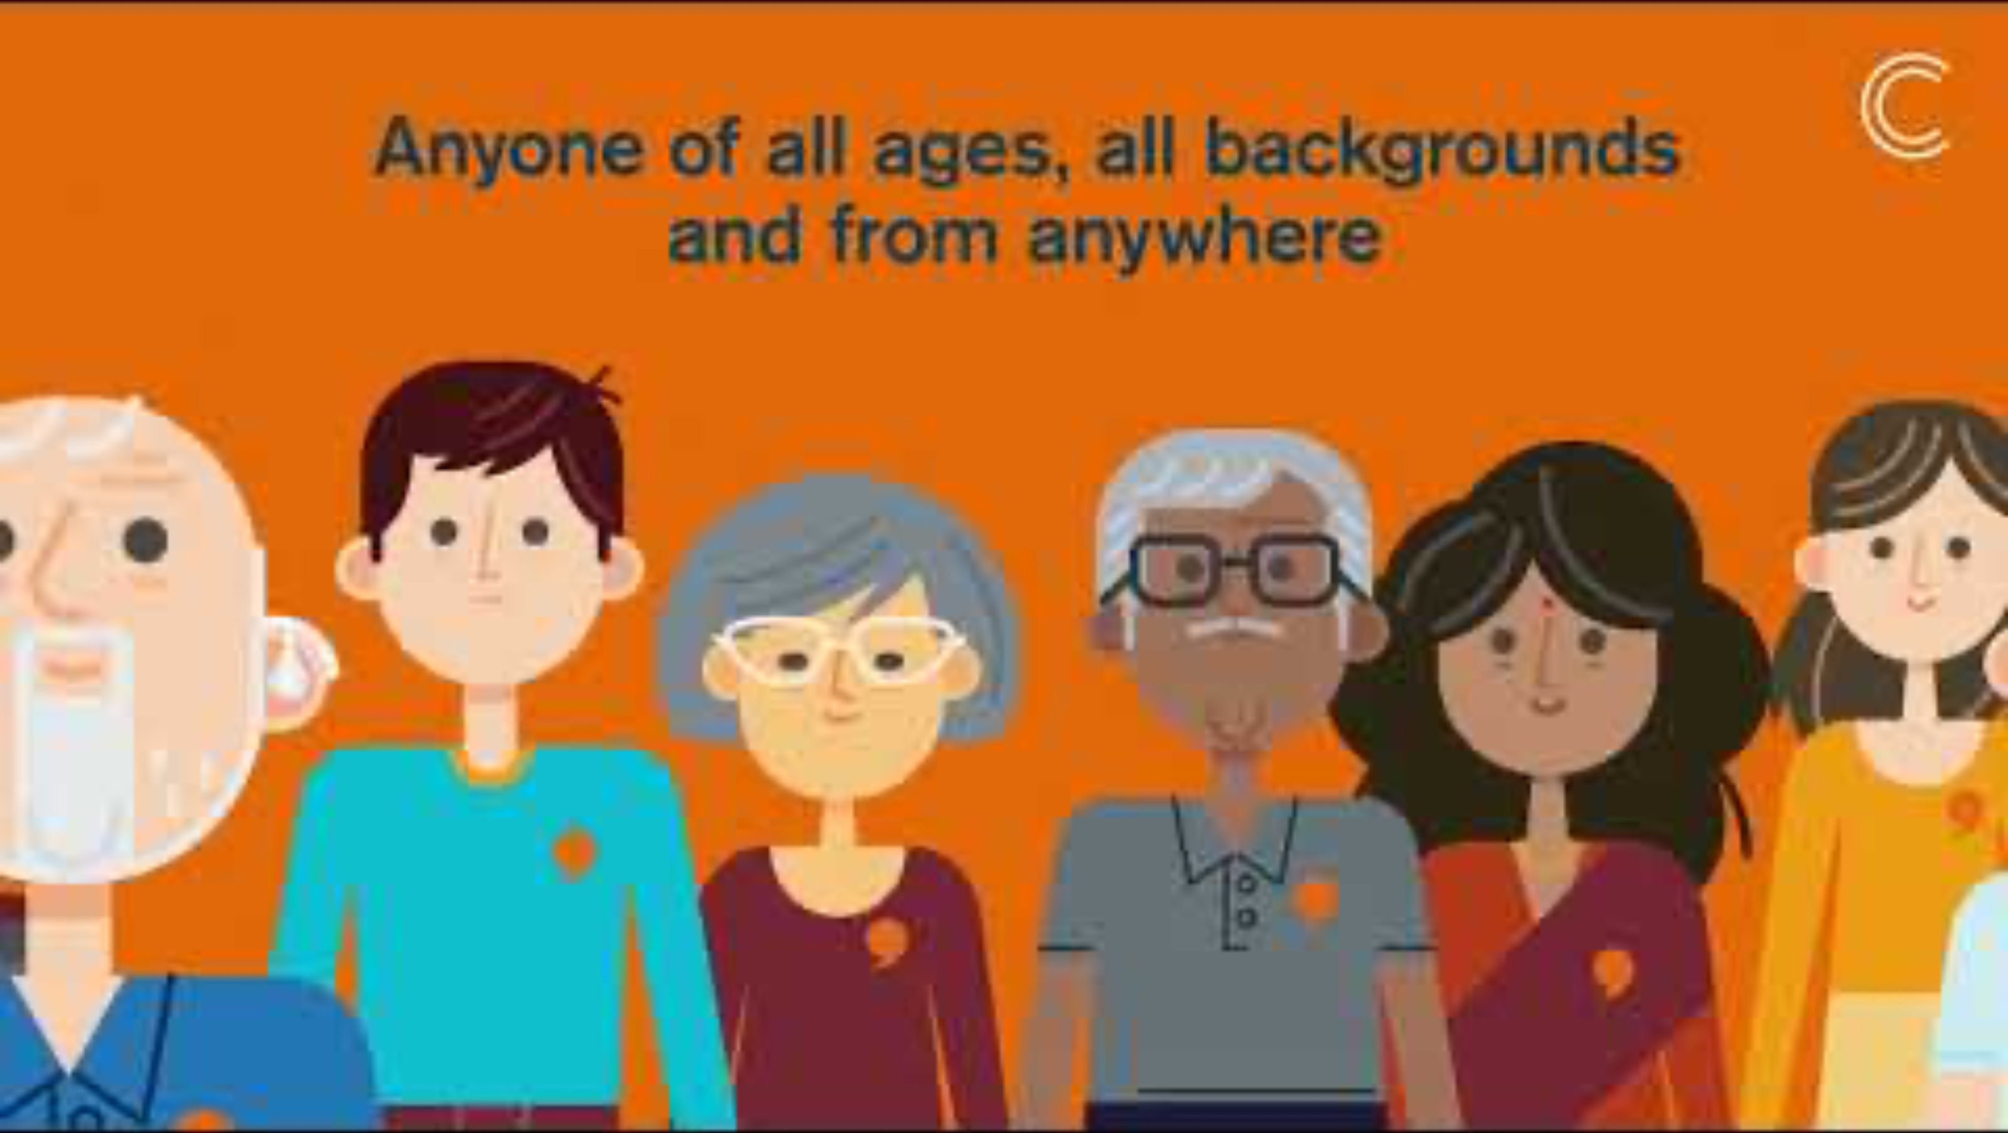
Fideo – Welsh Language Commissioner: The Facts

Slide 22
Some workplaces, e.g. Universities, Welsh Government and Health Boards, have to follow certain rules which are called the Welsh Language Standards.

Slide 23
Discussion work
What is the purpose
of rules? What kind
of rules do you have
to follow in your everyday life?

Slide 24
Who needs to follow the Welsh Language Standards?
The public bodies who follow these rules are:
Local Authorities
(including schools)
National Parks
The National Museum
S4C
Police forces
The Fire and Rescue Service
Universities
Health Boards
and many more.
Over time, more and more organisations will have to follow the Welsh Language Standards.

Slide 25
Discussion work
Do you think that
the Welsh Language Standards are important to encourage more people to use their Welsh every day?

Slide 26

Discussion work
Have you seen this logo being used?
Do you know what the logo’s purpose/ meaning is?

Slide 27
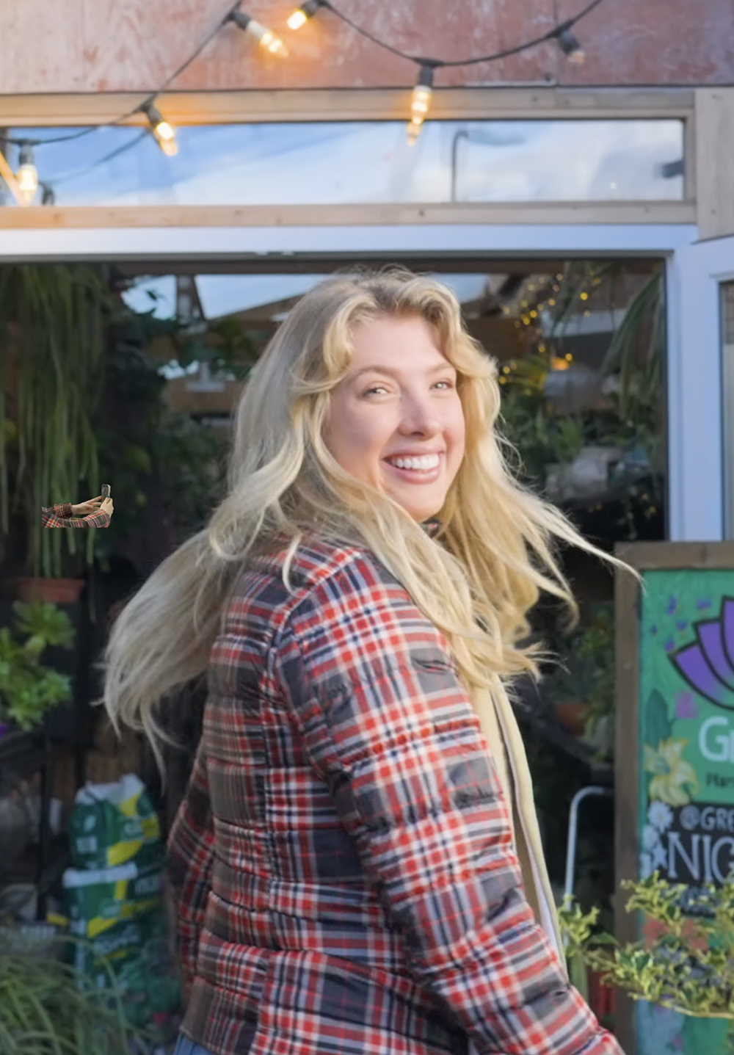
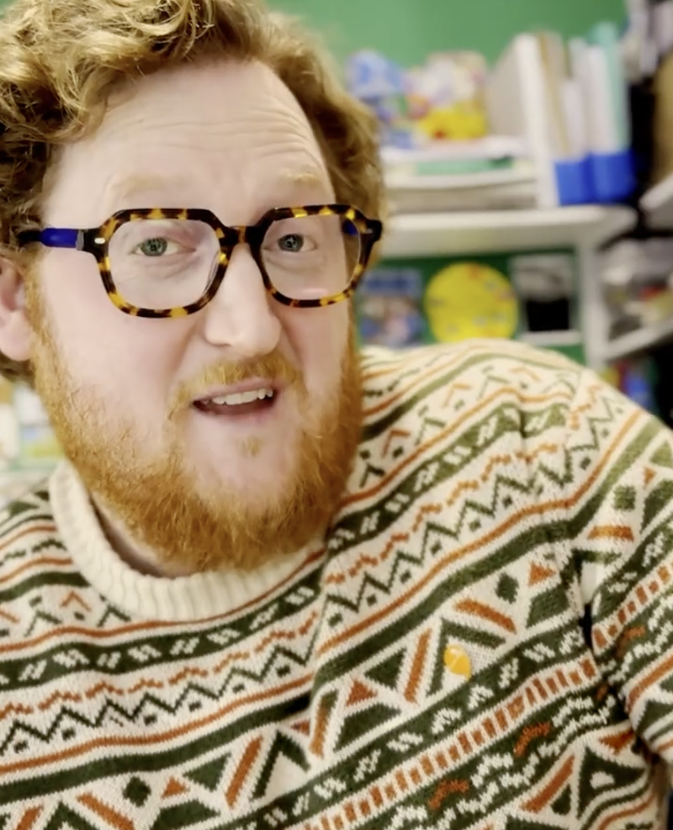
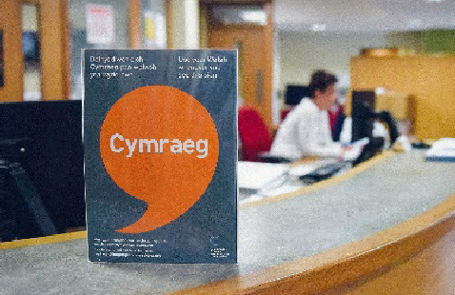
Iaith Gwaith (Working Welsh) Scheme
The logo is a symbol of the Welsh Language Commissioner’s Iaith Gwaith (Working Welsh) scheme.
The logo is 20 years old and lets people know that they can use the Welsh language – in the shop, in the supermarket, in the café, at the office or at school.
A Welsh language poem by Siôn Tomos Owen, the Welsh Language Children’s Poet, to celebrate the Iaith Gwaith scheme:
Defnyddia dy Gymraeg (Use your Welsh) video

Slide 28
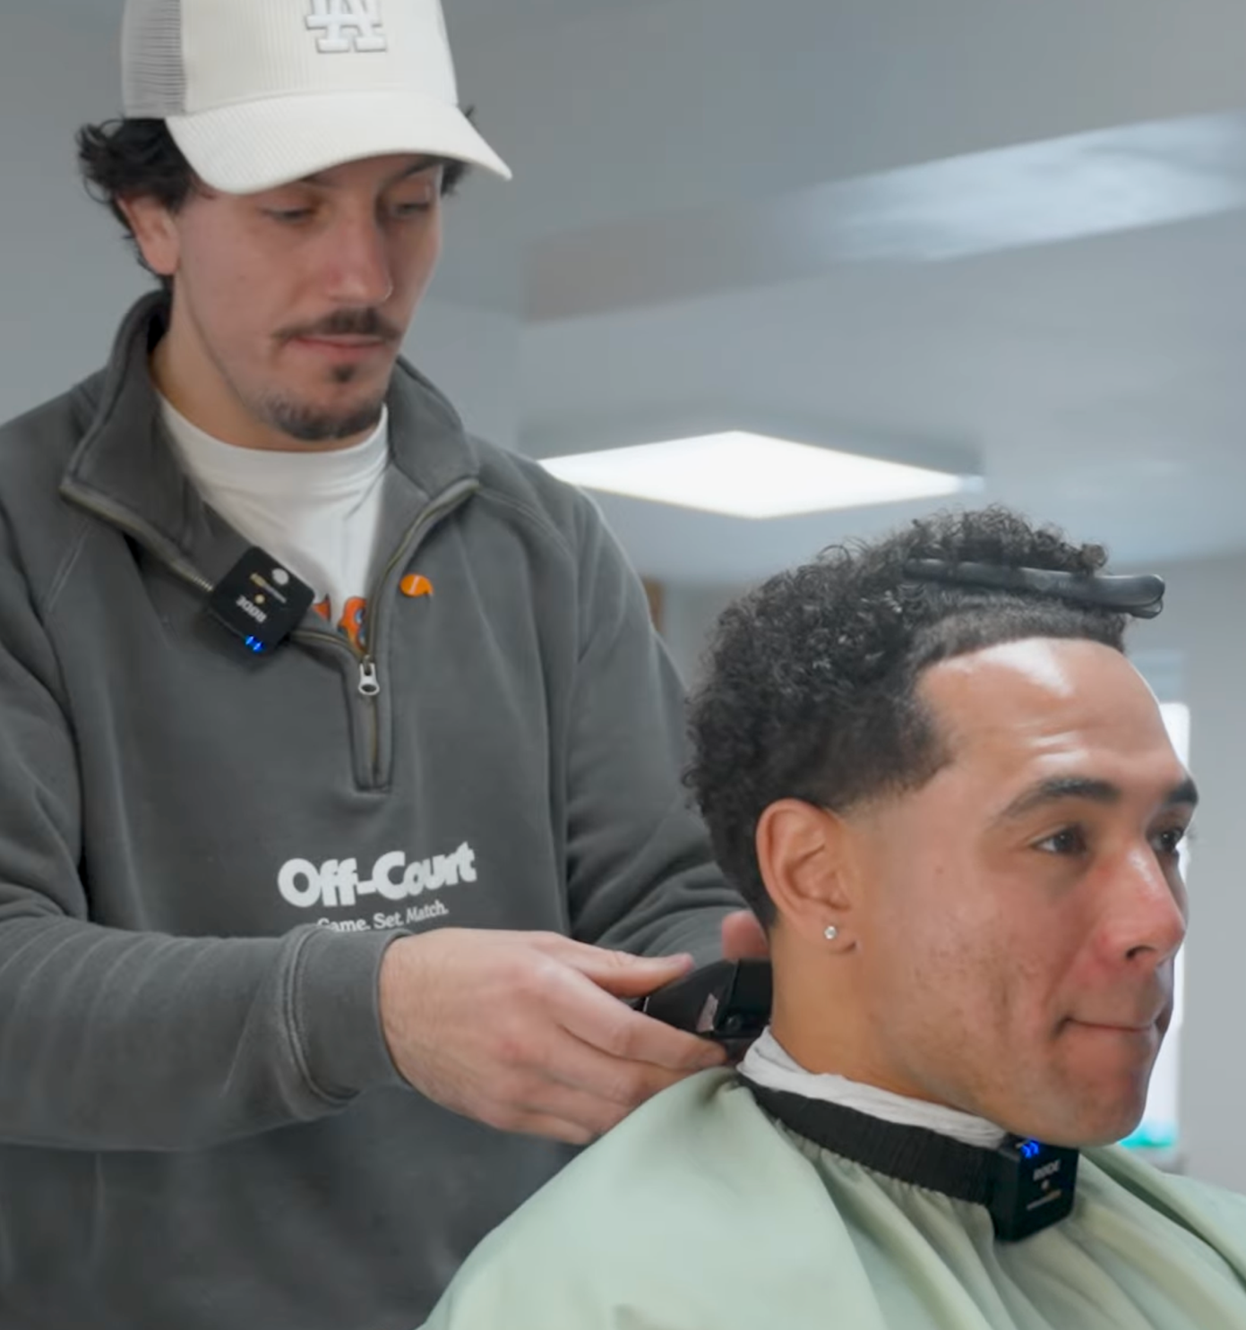
Learn more about how Lloyd Lewis uses his Welsh every day:

Slide 29
Discussion work
If you saw someone
wearing the badge with
the orange speech bubble, would you speak Welsh with them? Is this important,
in your opinion?

Slide 30
Private businesses and charities in Wales don’t have to stick to the Welsh Language Standards, but the Welsh Language Commissioner encourages them to use Welsh every day.

Slide 31






Examples of private businesses who use the Welsh language quite a lot in their work include:
Lidl and Aldi supermarkets
Boots
Principality
Undeb Rygbi Cymru
Xplore
(canolfan wyddoniaeth yn ardal Wrecam)

Slide 32





Examples of charities are:
WWF Cymru
NSPCC Cymru
Macmillan Cymru
RSPB Cymru
Gwobr Dug Caeredin

Slide 33
Discussion work
Do you use some Welsh in the shop or café?

Slide 34


Using Welsh
in sport
activities

Slide 35
Discussion work
Do you enjoy sports? Are you a member of any sports clubs outside of school?

Slide 36
Discussion work
Do you have
experience of taking part
in sports/ attending sports
clubs where Welsh is
used?

Slide 37
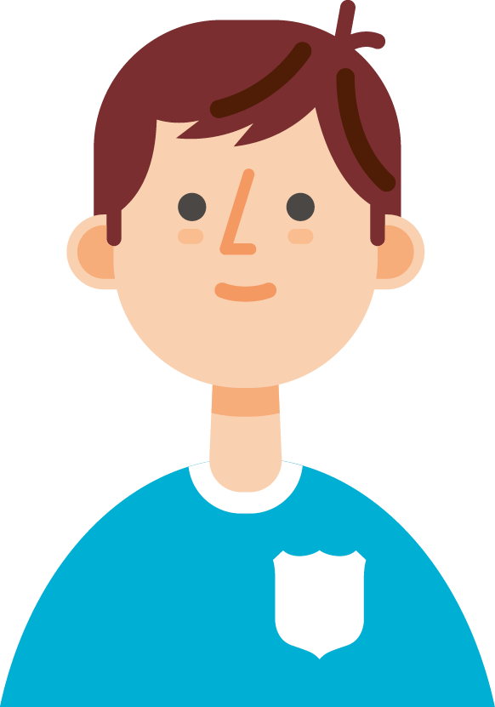
Did you know?
50% of children and young
people who speak Welsh want
more opportunities to take part in sports through the medium of Welsh.

Slide 38
Discussion work
Can you think of
reasons why sports clubs should use Welsh when coaching children and young people?

Slide 39
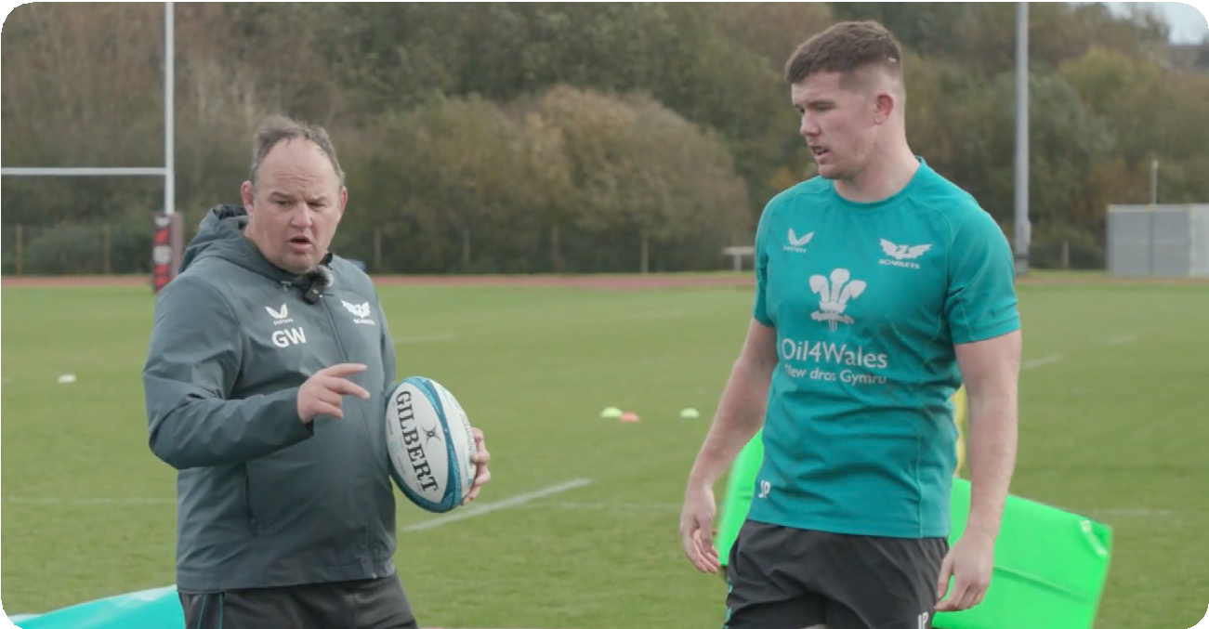

Scarlets video:
Use your
Welsh/ Defnyddia dy Gymraeg
- Scarlets.

Slide 40

What can we
do to use more Welsh?

Slide 41
Today, nearly
75%
of Welsh speakers see opportunities to use Welsh in their everyday life.

Slide 42
Discussion work
If you can speak some
Welsh, how much opportunity do you have to use Welsh every day? Do you have plenty of opportunity/ too little opportunity?

Slide 43
According to the Commissioner:
As the Welsh Language Commissioner,
I work to ensure that the people of Wales, including children, and young people like you, can enjoy using the Welsh language every day. I want for all of us to be able to use and speak Welsh as an exciting and vibrant language, which flourishes today and in the future.

Slide 44
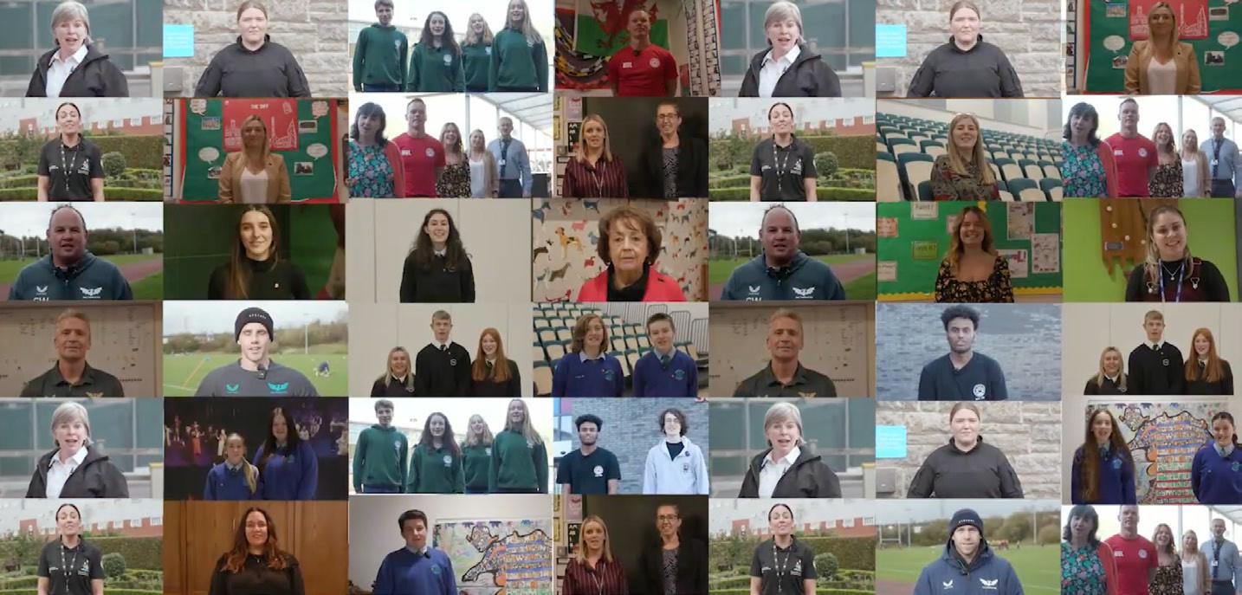
The Welsh language belongs to all of us and it is important that we all enjoy and use it as much as possible every day.
Defnyddia
Dy Gymraeg/ Use your Welsh

Slide 45
Discussion work
What can you do
to make use of any Welsh you have in your everyday life?

Slide 46
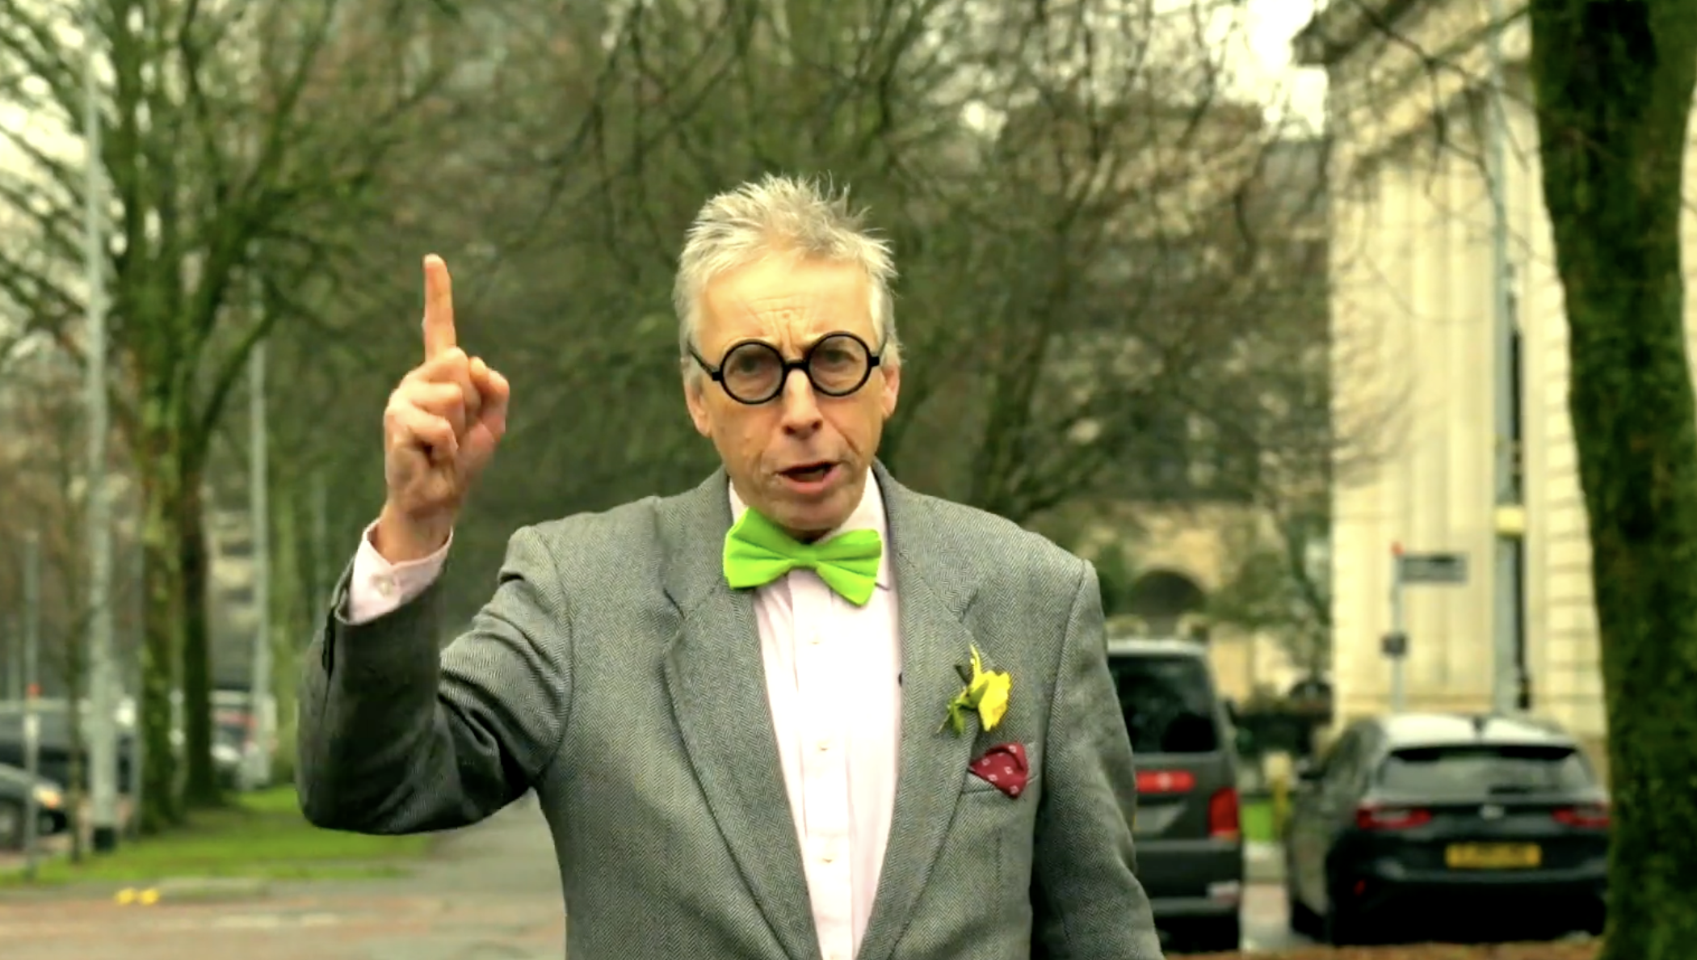
Listen to R.Ben Igwr talking to Efa Gruffudd Jones, the Welsh Language
Commissioner, about a special report she has published which talks about the
use of the Welsh language in Wales today. What interesting ideas does R.Ben Igwr have about making sure there will be a million Welsh speakers by 2050?!

Slide 47
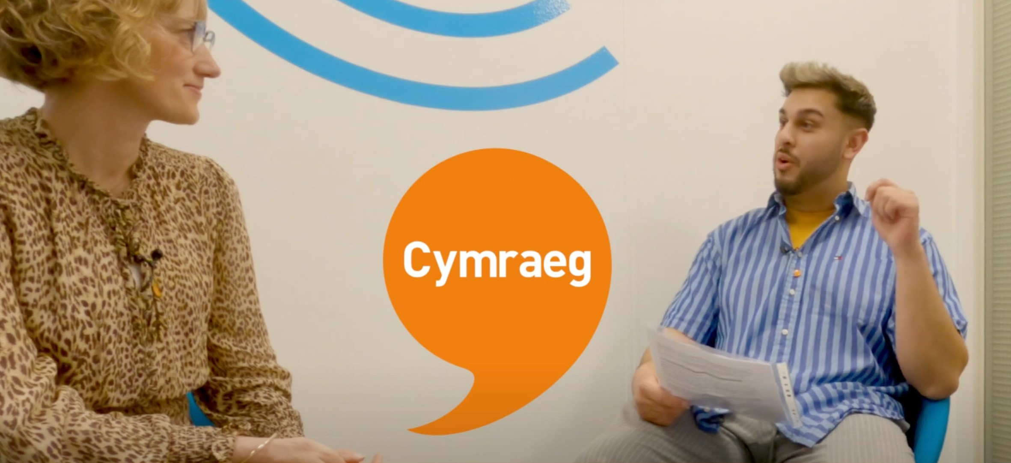
Closing message from Efa Gruffudd Jones, the Welsh Language Commissioner:
An interview with the Welsh Language Commissioner

Slide 48

Quiz

Slide 49

Around what percentage of the world's population is bilingual?
43%

Slide 50


On average, how many languages die somewhere in the world each year?
24 – 1 every 14 days

Slide 51

Can you think of three good things about being bilingual?
(See the statements
on slides 6 to 13)

Slide 52
The aim of the Welsh Government is to reach
a million Welsh speakers by which year?
2050
2046
2047
2048
2049
2051

Slide 53
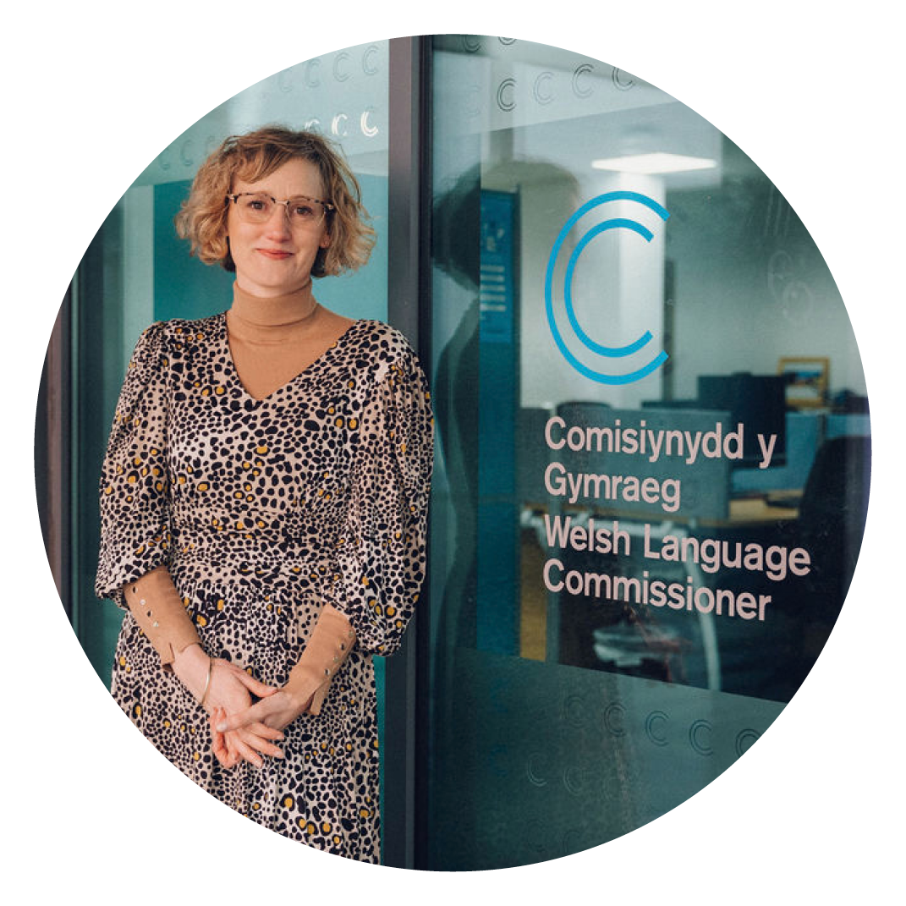
Who is the Welsh Language Commissioner and since when has she been
in post?
Efa Gruffudd Jones, since January 2023.

Slide 54
What does the Welsh Language Commissioner wish to see?
A Wales where people can use Welsh in their everyday life and live their life in Welsh.

