Slide 1
Why Policy Standards?
EMYR LEWIS
Welsh Language Commissioner Seminar 21.11.2023

Slide 2
article 7 European Charter for Regional and Minority Languages
1 In respect of regional or minority languages, within the territories in which such languages are used and according to the situation of each language, the Parties shall base their policies, legislation and practice on the following objectives and principles:
c the need for resolute action to promote regional or minority languages in order to safeguard them;
d the facilitation and/or encouragement of the use of regional or minority languages, in speech and writing, in public and private life;

Slide 3
article 7 European Charter for Regional and Minority Languages
2 The Parties undertake to eliminate, if they have not yet done so, any unjustified distinction, exclusion, restriction or preference relating to the use of a regional or minority language and intended to discourage or endanger the maintenance or development of it. The adoption of special measures in favour of regional or minority languages aimed at promoting equality between the users of these languages and the rest of the population or which take due account of their specific conditions is not considered to be an act of discrimination against the users of more widely-used languages
4 In determining their policy with regard to regional or minority languages, the Parties shall take into consideration the needs and wishes expressed by the groups which use such languages…

Slide 4
Background to Welsh Language (Wales) Measure 2011
Lack of official / legal status of the Welsh language within the framework of the law of England and Wales
The Welsh Language Act 1993
Board promoting and facilitating the use of the Welsh language
The concept of providing services - the 'soft law' model of the language schemes

Slide 5
Welsh Language (Wales) Measure 2011
Commissioner promotes and facilitates, but also...
Declares the official status of the Welsh language and
establishes the principle that the Welsh language should not be treated less favourably than the English language (equality of the Welsh language).

Slide 6
Welsh Language (Wales) Measure 2011
Creates a ‘harder’' system of standards
going beyond the provision of services
trying to ensure that the status, welfare and use of the Welsh language form part of the fabric of public life in Wales (promotion standards, operating standards) and
part of the responsibility of public bodies in Wales (compare legislation about the environment - in terms of principle if not in terms of legal nature).

Slide 7
The Policy Making Standards
Sections 26 and 29 of the Measure
Regulations (secondary legislation) made by Welsh Ministers
Prioritising
Use of the Welsh language and
The status of the Welsh language

Slide 8
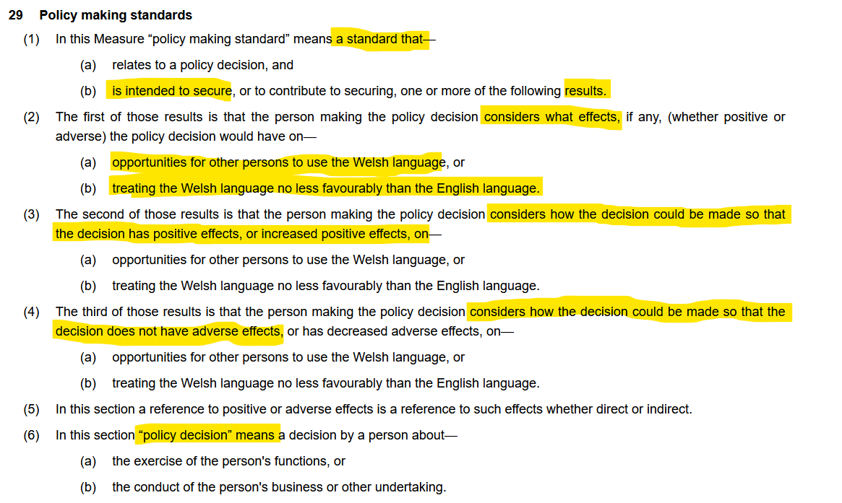

Slide 9
Types of Policy Making Standards
e.g. Schedule 2 of the Welsh Language Standards (No 1) Regulations 2015
Welsh Ministers, County and County Borough Councils, National Parks Authorities
Go beyond ‘considering’ by creating duties around the Process of gathering evidence in order to make a policy decision, reflecting the principles of best Practice in Public administration

Slide 10
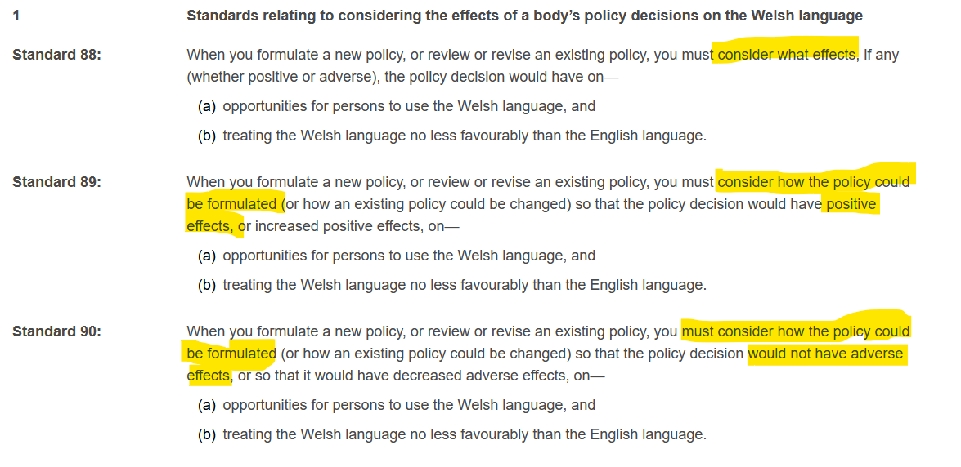

Slide 11
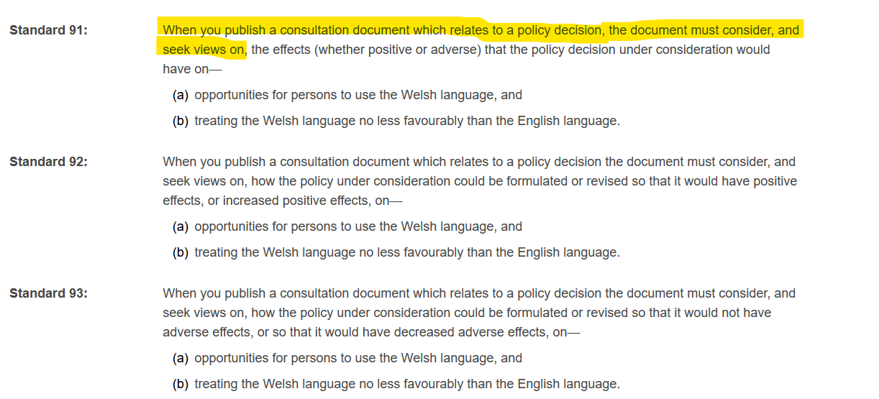

Slide 12
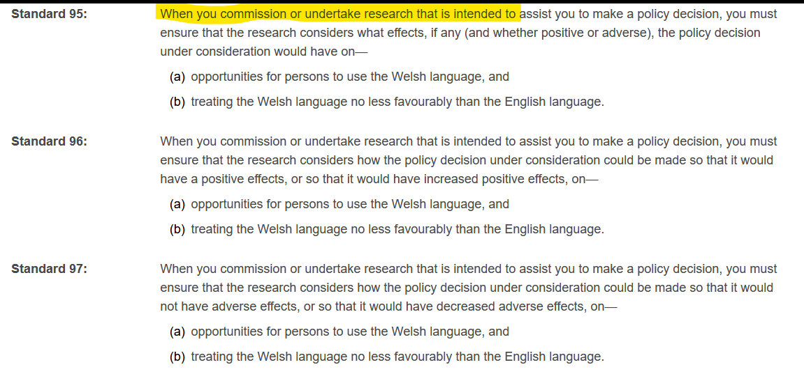

Slide 13
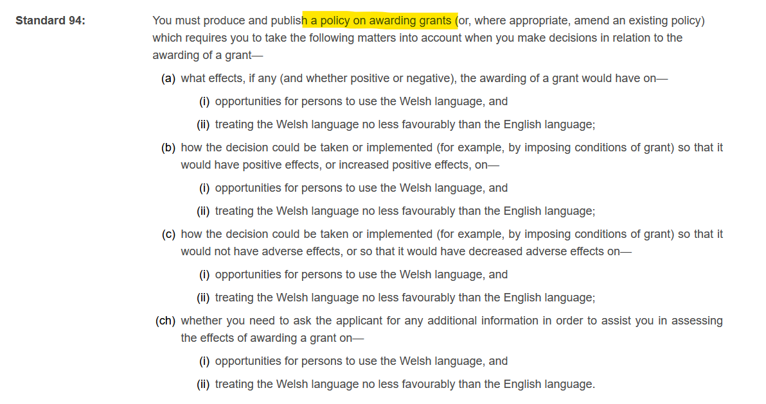

Slide 14
Summing up
The policy making standards:
go beyond the idea of Service provision, deriving from the Welsh Language Measure’s wider vision of ensuring that the Welsh language is part of the fabric of Welsh Public life and part of the responsibility of Public bodies
ensure that the Welsh language is considered as a mainstream topic as Public bodies decide how they go about exercising their Public functions
Focus on the flourishing of Welsh as a living language (opportunities to use Welsh) and the language’s equal status (and thus those of its speakers) with English
Fulfil the UK’s obligations under the European Charter and best Practice in Public Administration.

Slide 15
Y diwedd

